Slide 1
David Deutsch
and the Nature of Scientific Theories
A presentation by Otto Mättas
Notes:
This presentation explores David Deutsch's ideas about how we test and understand scientific theories,
particularly focusing on his contributions to quantum mechanics and constructor theory.

Slide 2
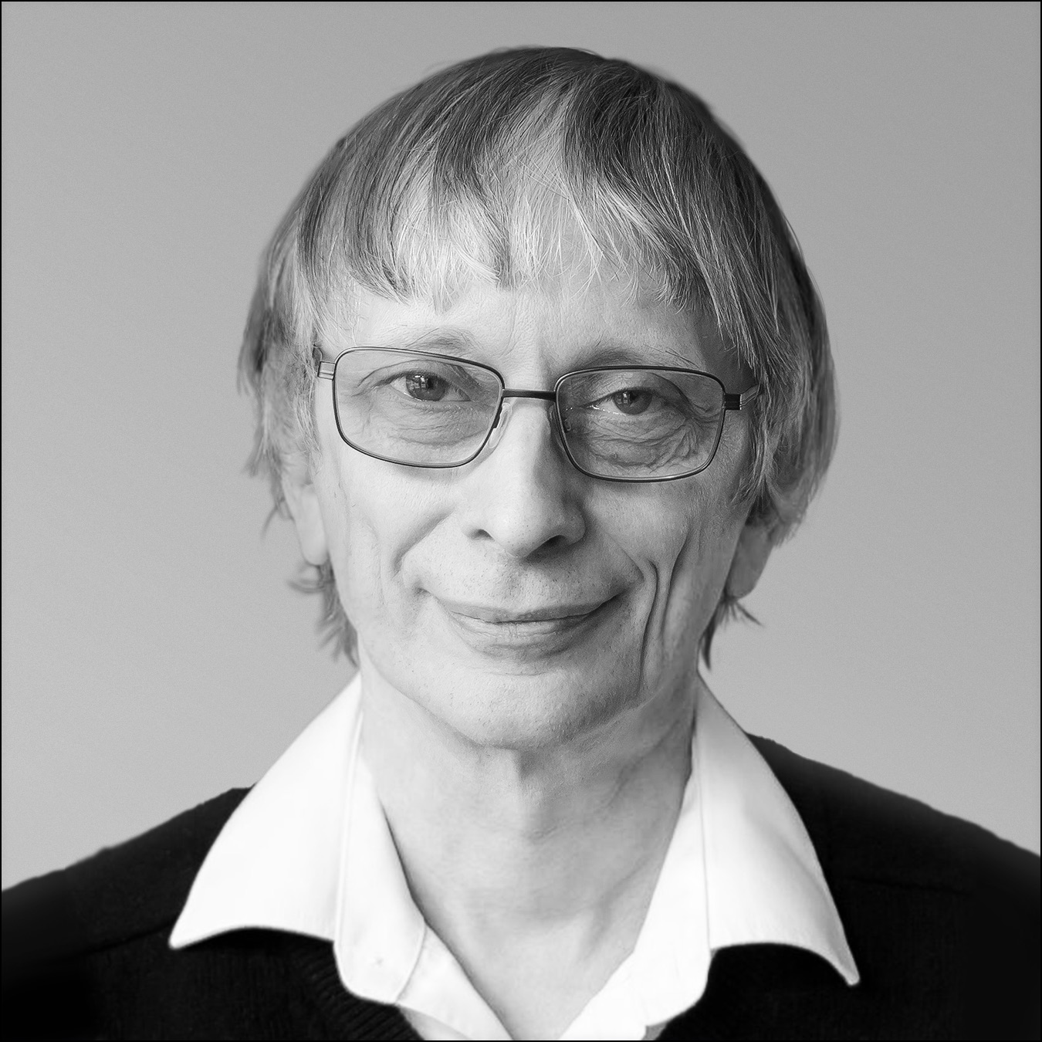
David Elieser Deutsch
b. 1953
Professor at University of Oxford
Royal Society
Institute of Physics
Known for contributions to quantum computing and describing quantum mechanics
Notes:
David Deutsch is one of today's most influential theoretical physicists and philosophers of science. Born in 1953, he is a professor at Oxford University and a pioneer in the field of quantum computation. His groundbreaking work has earned him Fellowship of the Royal Society and numerous other honors. He's particularly known for developing the quantum theory of computation and for his interpretations of quantum mechanics.

Slide 3
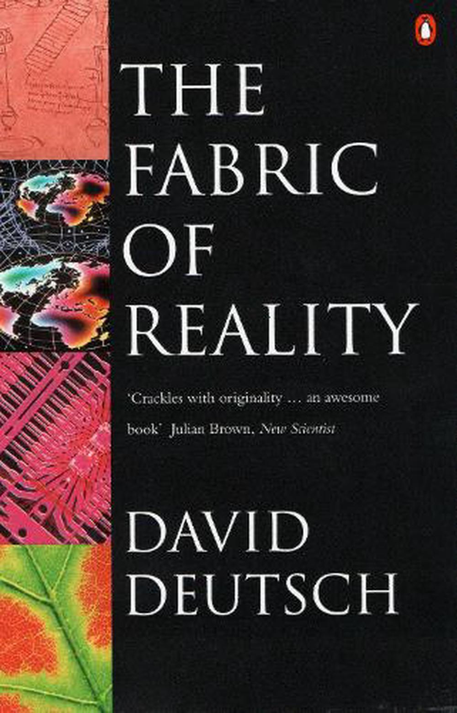
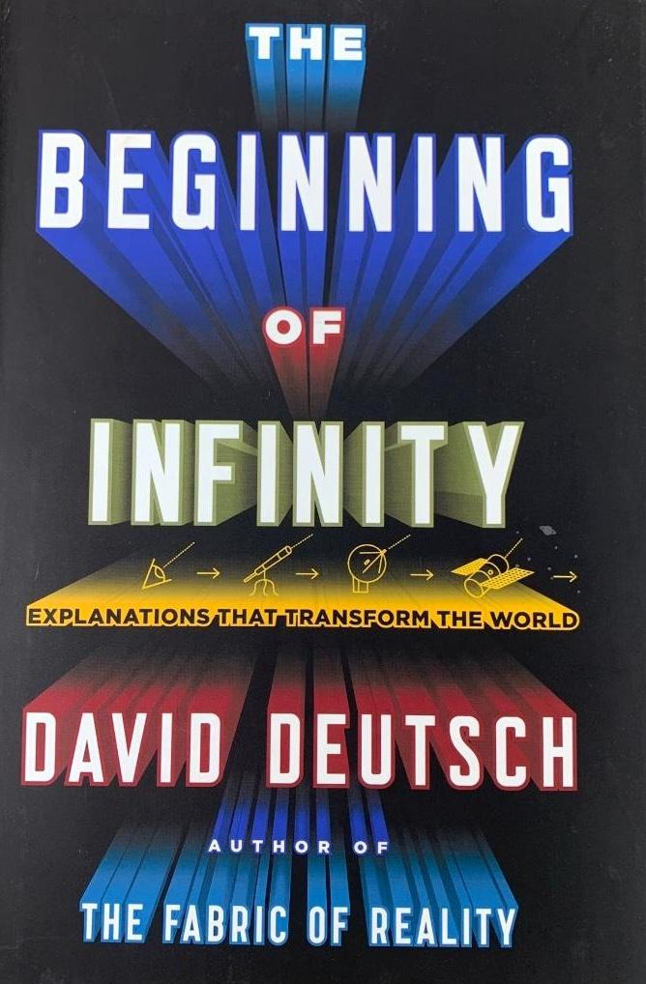
Notes:
Deutsch has written several influential books, including "The Fabric of Reality" and "The Beginning of Infinity."
These works go beyond pure physics to explore deep questions about reality, knowledge, and scientific explanation.
They connect fundamental physics with broader questions about knowledge and reality.

Slide 4
The Fundamental Challenge of Testing Theories
Notes:
At the heart of Deutsch's work is a fundamental question: How do we actually test scientific theories?
The traditional view relied heavily on probability and statistical inference, but Deutsch argues this approach has serious limitations.
He proposes we need a more fundamental way to understand how theories relate to reality.

Slide 5

The Traditional View
Assumes need for probabilistic axioms
Relies on inductive reasoning
Seeks confirmation/justification of theories
Notes:
The conventional approach to scientific testing assumes we need probabilistic axioms
It relies heavily on inductive reasoning (going from specific observations to general conclusions)
It seeks to confirm or justify theories through evidence
However, this approach has serious limitations and philosophical problems
A great example is weather forecasting before modern meteorology. Meteorologists would:
Use probabilistic axioms ("If we see these clouds, there's an X% chance of rain")
Rely heavily on inductive reasoning ("It rained the last 3 times we saw these conditions, so it will likely rain again")
Seek confirmation by collecting more similar observations This approach, while somewhat useful, couldn't explain why weather patterns occurred.

Slide 6
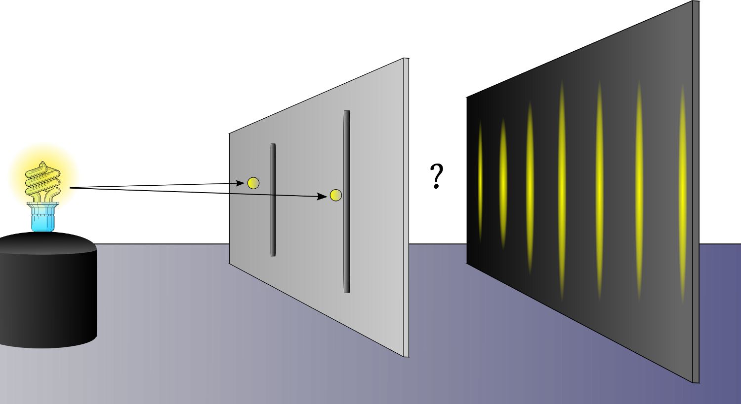
Deutsch’s Key Insight
Probabilistic behavior can emerge from non-probabilistic foundations
Testing doesn’t require probabilistic assumptions
Quantum mechanics demonstrates this principle
Notes:
Deutsch argues that probabilistic behavior can emerge from completely non-probabilistic foundations
We don't actually need probabilistic assumptions to test theories
Quantum mechanics provides a perfect example of this principle in action
This represents a fundamental shift in how we think about scientific testing
Consider the double-slit experiment in quantum mechanics:
Traditional view: We need probability to explain why particles appear in certain places
Deutsch's view: The apparent probabilistic behavior emerges from deterministic quantum mechanics - the particle actually takes all possible paths
Like how a river's flow appears random at small scales but follows precise physical laws

Slide 7
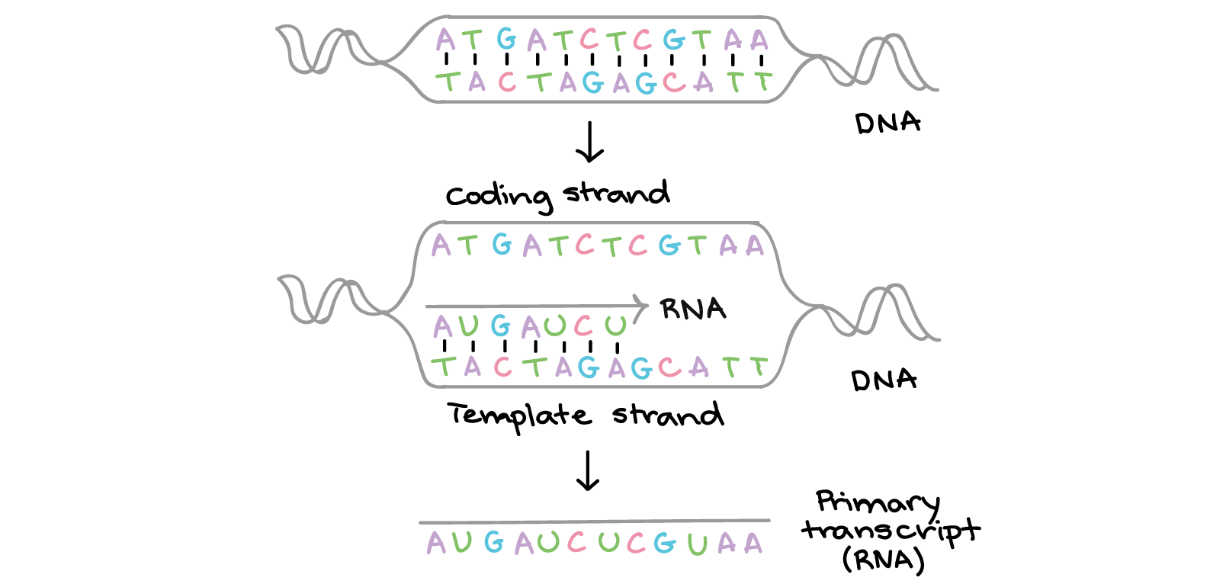
The Core Problem
How to test theories without relying on probability
Need for new framework beyond Bayesian reasoning
Challenge of connecting theory to experiment
Notes:
Deutsch identifies the central challenge: How can we test theories without relying on probability?
This leads to a need for a new framework that goes beyond traditional Bayesian reasoning.
The key is to understand how theories connect to experiments in a more fundamental way.
Let's use DNA sequencing as an example:
Traditional approach relies on statistical confidence levels to verify results
But what we really want to know is: Does this specific sequence actually represent the gene we're studying?
The challenge is connecting our theoretical understanding of genes to what we actually observe in experiments

Slide 8
The Constructor Theory Framework
Notes:
Constructor theory represents Deutsch's proposed solution.
Rather than asking "what happens?" it asks "what transformations are possible?"
This subtle shift has profound implications.

Slide 9

Basic Principles
Focus on possible vs impossible transformations
Laws expressed as constraints on transformations
Information as physical property
Notes:
Instead of predicting specific outcomes, we focus on identifying what transformations are possible versus impossible
Laws of physics are expressed as constraints on what can and cannot be done
Information becomes a physical property, not just an abstract concept
This approach avoids the problems of probability while maintaining predictive power
Think about digital information:
Focus on possible vs impossible: You can copy digital information perfectly, but you cannot copy unknown quantum states
Laws as constraints: You cannot create a perpetual motion machine
Information as physical: A hard drive stores information through physical magnetic states

Slide 10
Key Concepts
Tasks and constructors
Meta-laws that constrain other theories
Universality of computation
Notes:
Tasks and constructors: Anything that can cause transformations while retaining its ability to do so again
Meta-laws: Principles that constrain what other theories can say
Universality of computation: The idea that there are fundamental limits to what can be computed, regardless of the physical system used

Slide 11
Relationship to Testing
Provides framework for understanding possibilities
Connects physical laws to information processing
Enables non-probabilistic analysis
Notes:
Constructor theory provides a clear framework for understanding what's possible
It connects physical laws directly to information processing
This enables analysis without needing probabilistic assumptions
We can make precise predictions without relying on statistical interpretations

Slide 12
Problems with Traditional Approaches

Slide 13

The Bayesian Framework
Popper-Miller theorem limitations
Problems with credence assignment
Failure to capture explanatory power
Notes:
There are some limitations to the Bayesian Framework:
Issues with assigning probabilities to theories
Problems with credence (degree of belief) assignments
Failure to capture the explanatory power of theories
Consider medical diagnosis:
A test is 99% accurate for a disease that affects 1% of the population
Bayes' theorem tells us a positive result only means ~50% chance of having the disease
This shows how pure probability can be misleading without considering the underlying explanations

Slide 14

The Inductivist Mistake
Cannot derive theories from observations
Role of creative conjecture
Limitations of empirical generalisation
Notes:
The Inductivist Mistake:
We can't derive theories purely from observations
Creative conjecture plays a crucial role
Empirical generalisations have inherent limitations
The classic example is the black swan:
Europeans had only seen white swans and inducted "all swans are white"
Finding black swans in Australia falsified this
Shows why we can't reliably derive theories just from observations

Slide 15
The Authority Problem
False search for justification
Misunderstanding of scientific knowledge
Problems with confirmation theory
Notes:
Traditional scientific approaches rely heavily on finding "authority" or absolute confirmation for theories
This creates several key issues:
False search for infallible justification of theories
Misunderstanding of scientific knowledge as needing certainty
Problems with confirmation theory trying to provide absolute proof
Alternative view: Science works through finding and correcting errors, not seeking perfect authority
Focus should be on explanatory power and critical testing rather than absolute confirmation
Accept theories provisionally based on explanatory merit, not dogmatic authority

Slide 16
A Better Framework for Testing

Slide 17
Focus on Explanations
Good explanations are hard to vary
Must account for phenomena
Connection to reality
Critical Testing
Identifying problems and flaws
Role of crucial experiments
Importance of precision
Theory Improvement
Error correction process
Role of creative solutions
Progress through criticism
Notes:
Focus on Explanations:
Good explanations are hard to vary arbitrarily
Must account for observed phenomena
Should connect to physical reality in testable ways
Critical Testing:
Look for specific problems and flaws in theories
Use crucial experiments to decide between competing explanations
Precision matters but perfection isn't required
Theory Improvement:
Scientific progress happens through fixing errors
Creative solutions emerge to solve problems
Criticism drives progress forward

Slide 18
Applications to Quantum Mechanics

Slide 19
Quantum Probability
Emergence from deterministic laws
Role of rational decision theory
Non-probabilistic foundations
Experimental Tests
Testing without probabilistic axioms
Role of measurement theory
Implications for quantum computing
Theoretical Insights
Nature of quantum superposition
Understanding measurement
Role of information
Notes:
Quantum Probability:
Emerges naturally from deterministic laws
Uses rational decision theory
Doesn't require probabilistic foundations
Experimental Tests:
Can test quantum theories without probabilistic assumptions
Measurement theory plays key role
Has implications for quantum computing development
Theoretical Insights:
Helps understand quantum superposition
Clarifies measurement problem
Shows role of information in quantum mechanics

Slide 20
Practical Implications

Slide 21
Scientific Method
New approach to theory testing
Role of explanations
Importance of criticism
Technology Development
Implications for quantum computing
Role of constructor theory
Future directions
Philosophical Impact
Nature of scientific knowledge
Role of probability
Future of physics
Notes:
Scientific Method:
Emphasis on explanations rather than just predictions
Importance of criticism and problem-solving
Focus on understanding constraints rather than just outcomes
Technology Development:
New insights for quantum computing
Clearer understanding of what technology can and cannot achieve
Better framework for predicting future developments
Philosophical Impact:
New understanding of scientific knowledge
Clearer role for probability in science
Points toward future developments in physics

Slide 22
Discussion Points

Slide 23
Thought Experiments
The coin toss explanation
The two games scenario
The calendar prediction problem
Notes:
The coin toss explanation
Bayesian Example:
Imagine you have a coin, and you want to determine if it’s fair (50-50 chance of heads or tails) or biased. A Bayesian approach would start with a prior belief about the coin’s fairness (e.g., you might start by assuming it’s fair). Then, you update this belief based on the outcomes of repeated tosses. If you observe many heads in a row, your belief about the coin being biased would increase probabilistically.
Deutsch Example:
In a this (Popperian) approach, you would form a hypothesis such as “The coin is fair.” To test this hypothesis, you would conduct experiments (coin tosses) to see if you can falsify it. If you repeatedly get an unlikely number of heads or tails (based on what you would expect from a fair coin), you might consider the hypothesis falsified.
So, Bayesian epistemology focuses on updating the likelihood of the coin being fair or biased based on evidence, while Popperian epistemology involves trying to falsify a hypothesis through experimentation. This example might help your audience grasp the fundamental differences in these epistemological approaches.
2.The Two Games Scenario
Present two quantum games:
Game A: Get $100 if a quantum measurement gives "up"
Game B: Get $50 regardless of measurement
Ask: "Which would you choose and why?"
Discussion: How we make decisions under quantum uncertainty
Reveals: People naturally apply decision theory without probability axioms
3. The calendar prediction problem
Ask: "For decades, calendars showed years beginning with '19'. How many of you would have predicted in 1995 that soon they would show '20'?"
Discussion: Why we could predict this despite never experiencing it
Key Point: Shows how explanation trumps induction from past experience

Slide 24
Key Questions
What makes a scientific theory good?
If past experiments support a theory, does that make it true?
How do you make decisions when outcomes are uncertain?

Slide 25
In Conclusion
The power of explanation
The role of testing
The future of physics
Notes:
Constructor theory offers a powerful new way to understand scientific theories
It solves long-standing problems in how we test theories
Most importantly, it opens new possibilities for future scientific development
The emphasis on what's possible rather than just what happens represents a fundamental shift in how we think about physics

